Slide 1
CSE 519: Data Science
Steven Skiena
Stony Brook University
Lecture 7: Data Cleaning

Slide 2
Data Compatibility
Data needs to be carefully massaged to make ``apple to apple’’ comparisons:
Unit conversions
Number / character code representations
Name unification
Time/date unification
Financial unification

Slide 3
Unit Conversions
NASA’s Mars Climate Orbiter exploded in 1999 due to a metric-to-English conversion issue.
Even sticking to the metric system has potential inconsistencies: cm, m, km?
Bimodal distributions can indicate trouble
Z-scores are dimensionless quantities.
Vigilance in data integration is essential.

Slide 4
Number / Character Representations
The Ariane 5 rocket exploded in 1996 due to a bad 64-bit float to 16-bit integer conversion.
Measurements should generally be decimal numbers
Counts should be integers.
Fractional quantities should be decimal, not (q,r) like (pounds,oz) or (feet,inches).

Slide 5
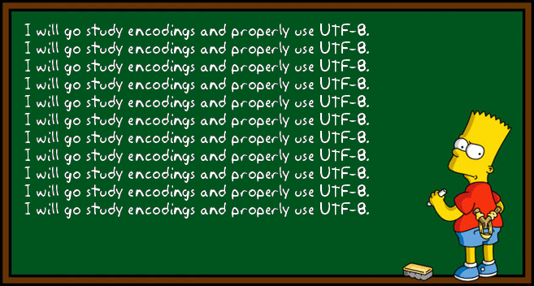
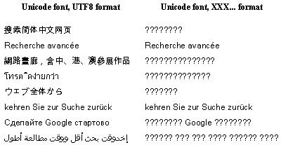
Character Representations
A particularly nasty cleaning issue in textual data is unifying character code representations:
ISO 8859-1 is a single byte code for ASCII
UTF-8 is a multibyte encoding for all Unicode characters.
Notes:
http://perltricks.com/article/building-a-utf-8-encoder-in-perl/

Slide 6
Name Unification
I appear on the web as:
(Steve|Steven|S.) (S.|Sol|_) (Skiena|Skeina|Skienna)
Use simple transformations to unify names, like lower case, removing middle names, etc.
Consider phonetic hashing methods like Soundex and Metaphone.
Tradeoff between false positives and negatives.

Slide 7
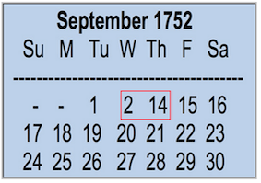
Time / Date Unification
Aligning temporal events from
different datasets/systems can be problematic.
Use Coordinated Universal Time (UTC), a modern standard subsuming GMT.
Financial time series are tricky because of weekends and holidays: how do you correlate stock prices and temperatures?

Slide 8
Financial Unification
Currency conversion uses exchange rates.
Correct stock prices for splits and dividends.
Use returns / percentage change instead of absolute price changes.
The time value of money needs correction for inflation for fair long-term comparisons.
Why do stock/oil prices correlate over 30 years?

Slide 9
Dealing with Missing Data
An important aspect of data cleaning is properly representing missing data:
What is the year of death of a living person?
What about a field left blank or filled with an obviously outlandish value?
The frequency of events too rare to see?
Setting such values to zero is generally wrong

Slide 10
Imputing Missing Values
With enough training data, one might drop all records with missing values, but we may want to use the model on records with missing fields
Often it is better to estimate or impute missing values instead of leaving them blank.
A good guess for your death year is birth+80.

Slide 11
Imputation Methods
Mean value imputation - leaves mean same.
Random value imputation - repeatedly selecting random values permits statistical evaluation of the impact of imputation.
Imputation by interpolation - using linear regression to predict missing values works well if few fields are missing per record.

Slide 12
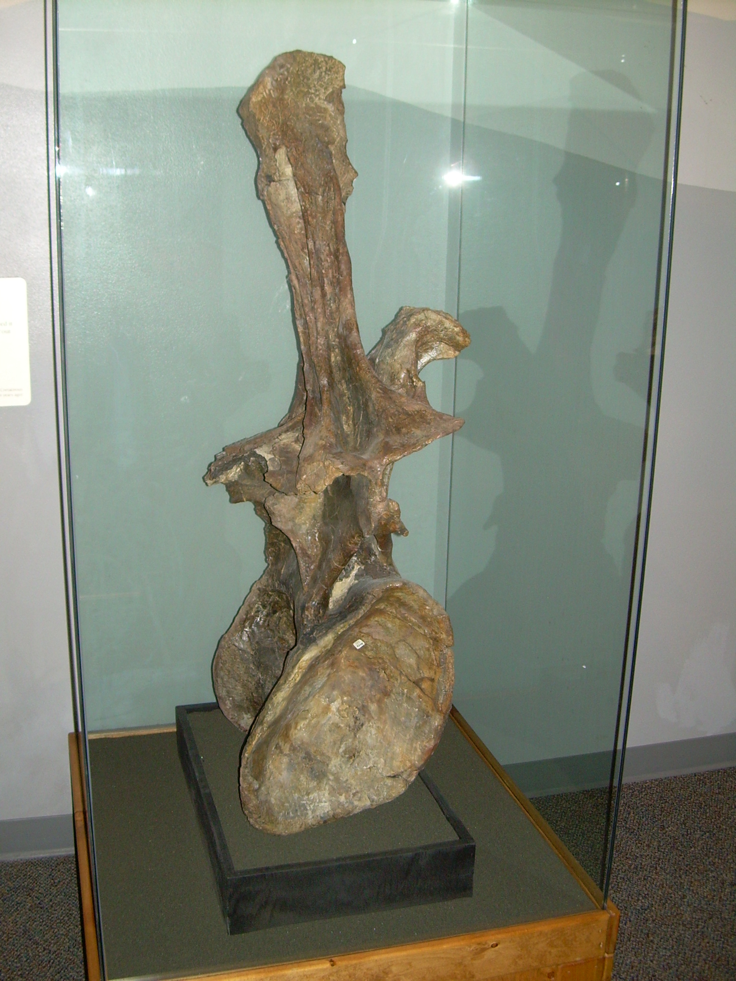
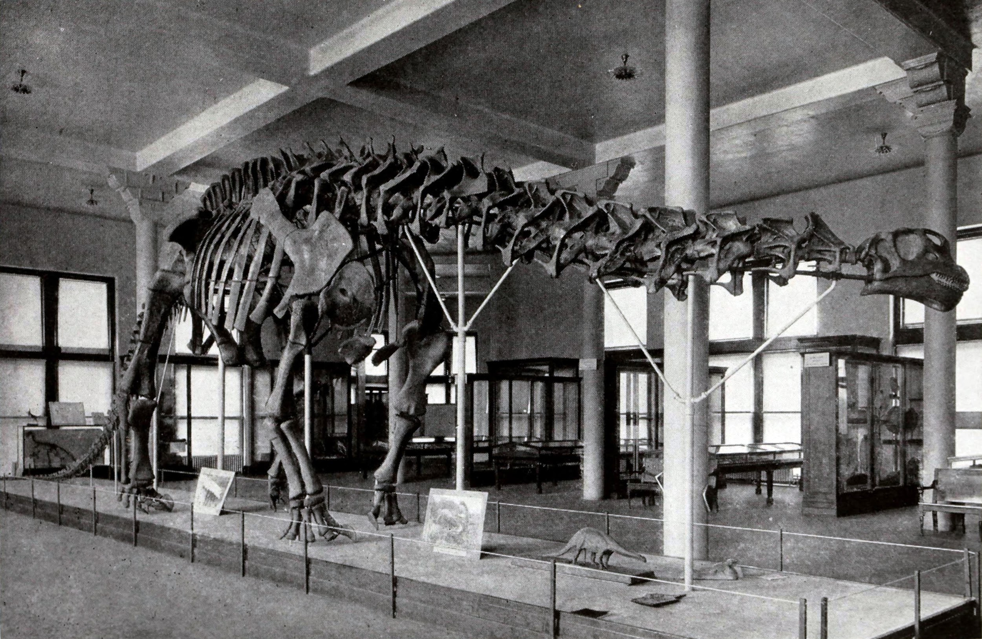
Outlier Detection
The largest reported dinosaur vertebra is 50% larger than all others: presumably a data error.
Look critically at the maximum and minimum values for all variables.
Normally distributed data should not have large outliers, k sigma from the mean.
Fix why you have an outlier. Don’t just delete.

Slide 13
Detecting Outliers
Visually, it is easy to detect outliers, but only in low dimensional spaces.
It can be thought of as an unsupervised learning problem, like clustering.
Points which are far from their cluster center are good candidates for outliers

Slide 14
Delete Outliers Prior to Fitting?
Deleting outliers prior to fitting can yield better models, e.g. if these points correspond to measurement error.
Deleting outliers prior to fitting can yield worse models, e.g. if you are simply deleting points which are not explained by your simple model.

